Slide 1
Computer Networks (CSGE301)
K K S Gautam
Assistant Professor
Department of Computer Science
Shivaji College, Raja Garden New Delhi
kksgautam@Shivaji.du.ac.in

Slide 2
UNIT II
Network Models: Client/ server network and Peer-to-peer network,
OSI, TCP/IP, layers and functionalities.

Slide 3
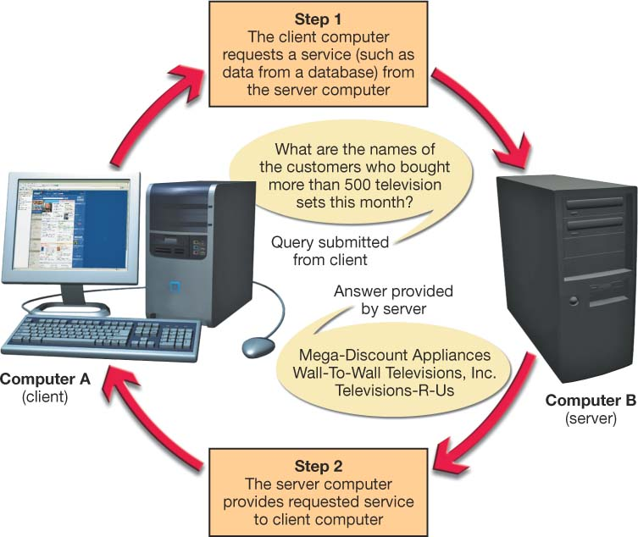
Client/Server Networks
Server-based network
  Clients and servers
Data flows efficiently
Servers respond to requests from clients
Servers perform specific tasks
Scalable network
Centralized
Notes:
To review, a server is a computer that both stores and shares resources on a network, whereas a client is a computer that requests those resources.
A client/server network contains servers as well as client computers. The inclusion of servers is what differentiates a client/server network from a typical peer-to-peer (P2P) network.
The main advantage of a client/server relationship is that it makes data flow more efficiently than in peer-to-peer networks. Servers can respond to requests from a large number of clients at the same time.
Also, servers are configured to perform specific tasks (such as handling e-mail or database requests) efficiently.
Client/server networks are also scalable network, meaning additional users can be added easily without affecting the performance of the other network nodes.
In addition, whereas P2P networks are decentralized (users are responsible for creating their own data backups and for providing security for their computer), client/server networks are centralized, meaning all clients connect to a server that performs tasks for them.

Slide 4
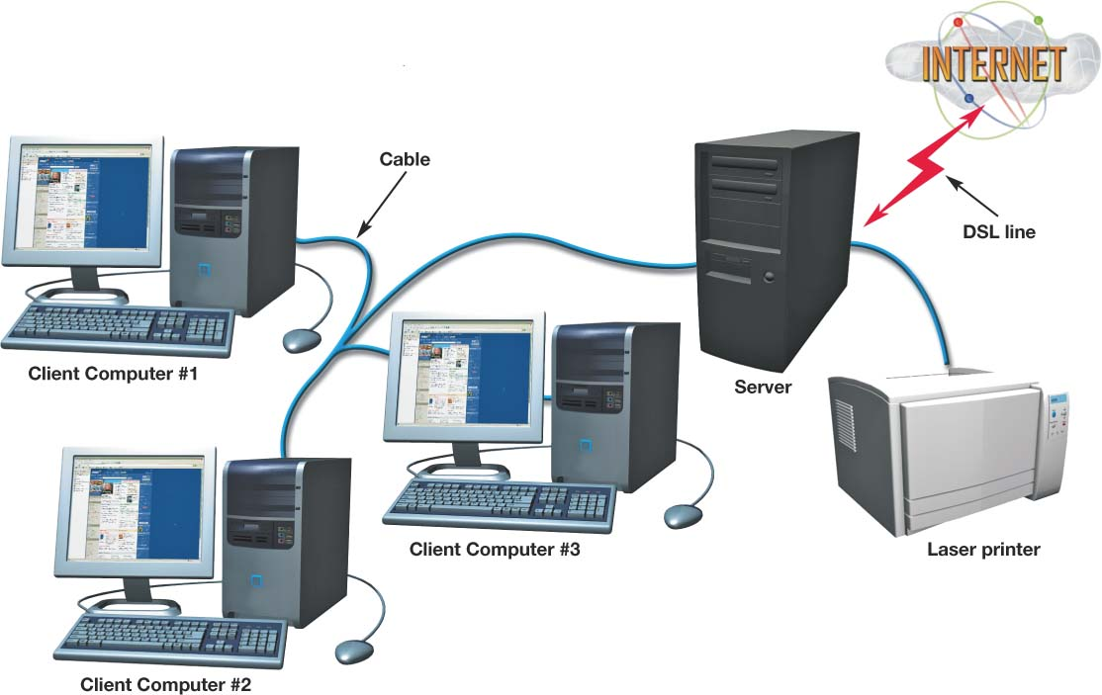
Classifications of
Client/Server Networks
LAN
  Local area network
  Computers linked together over a small geographic region
Notes:
Local area networks (LANs) are generally smaller groups of computers and peripherals linked together over a relatively small geographic area.
The computer lab at your school or the network on the floor of the office where you work is probably a LAN..

Slide 5
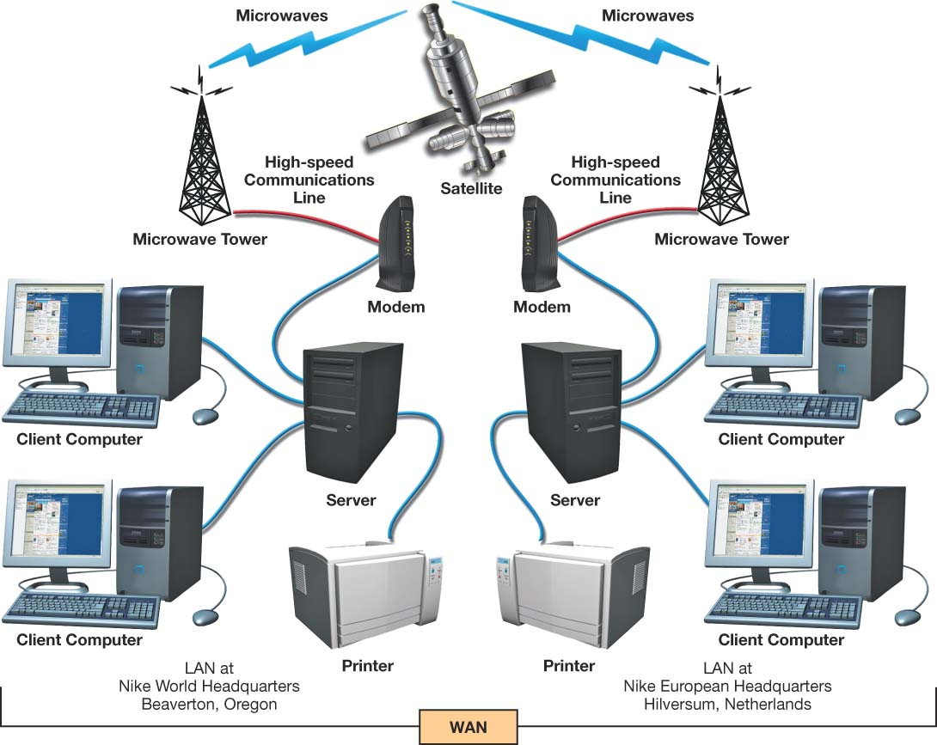
Classifications of
Client/Server Networks
WAN
  Wide area network
  Computers linked over large geographic locations
MAN
  Metropolitan area network
  Computers linked together within a city or county
Notes:
For large companies that operate at diverse geographic locations, a LAN is not sufficient for meeting their computing needs. Wide area networks (WANs) comprise large numbers of users or separate LANs that are miles apart and linked together. Corporations often use WANs to connect two or more geographically diverse branches.
Sometimes government organizations or civic groups establish WANs to link users in a specific geographic area (such as within a city or county). These special type of WANs are known as metropolitan area networks (MANs).

Slide 6
Classifications of
Client/Server Networks
PAN
  Personal area network
  Wireless devices connected in close proximity to each other
Intranet
  Private corporate network
  Protected by a firewall
Notes:
Personal area networks (PANs) are used to connect wireless devices (such as Bluetooth-enabled devices) in close proximity to each other. PANs are wireless and operate in the personal operating space of an individual, which is generally defined to be within 30 feet of your body.
An intranet is a private corporate network that is used exclusively by company employees to facilitate information sharing, database access, group scheduling, videoconferencing, or other employee collaboration. The intranet is not accessible to non-employees; a firewall protects it from the Internet.

Slide 7
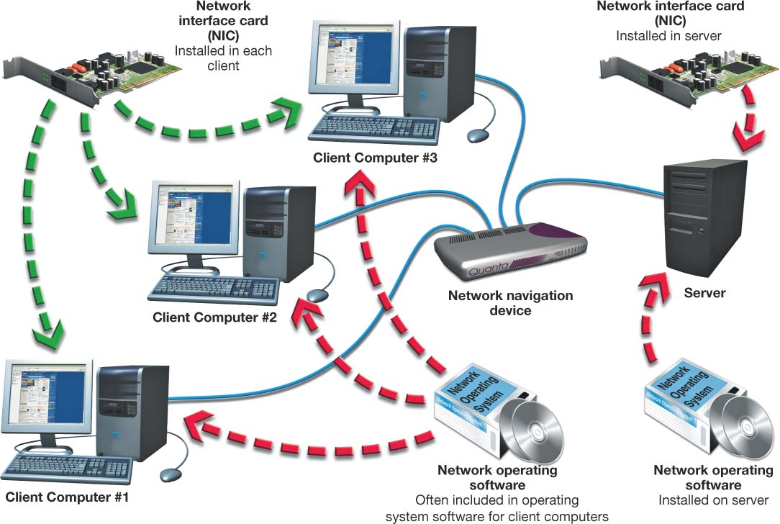
Constructing
Client/Server Networks
Servers
Network topologies
Transmission media
Network operating system (NOS)
Network adapters
Network navigation devices
Notes:
Client/server networks share many of the same components of P2P networks as well as some components specific to client/server networks:
- Server. Unlike P2P networks, client/server networks contain at least one computer that functions solely as a server.
- Network topology. Because client/server networks are more complex than P2P networks, the layout and structure of the network must be carefully planned.
- Transmission media. Transmission media (cable or wireless communications technology) is needed based on the network topology. Client/server networks use a wider variety of cable types than do simpler P2P networks.
- Network operating system (NOS) software. All client/server networks require network operating system (NOS) software, which is specialized software that is installed on servers and client computers that enables the network to function.
- Network adapters. Network adapters (or network interface cards) are attached or installed to each device on a client/server network. These adapters enable the computer (or peripheral) to communicate with the network using a common data communication language, or protocol.
- Network navigation devices. Because of the complexity of a client/server network, specialized network navigation devices (such as routers, hubs, and switches) are needed to move data signals around the network.

Slide 8
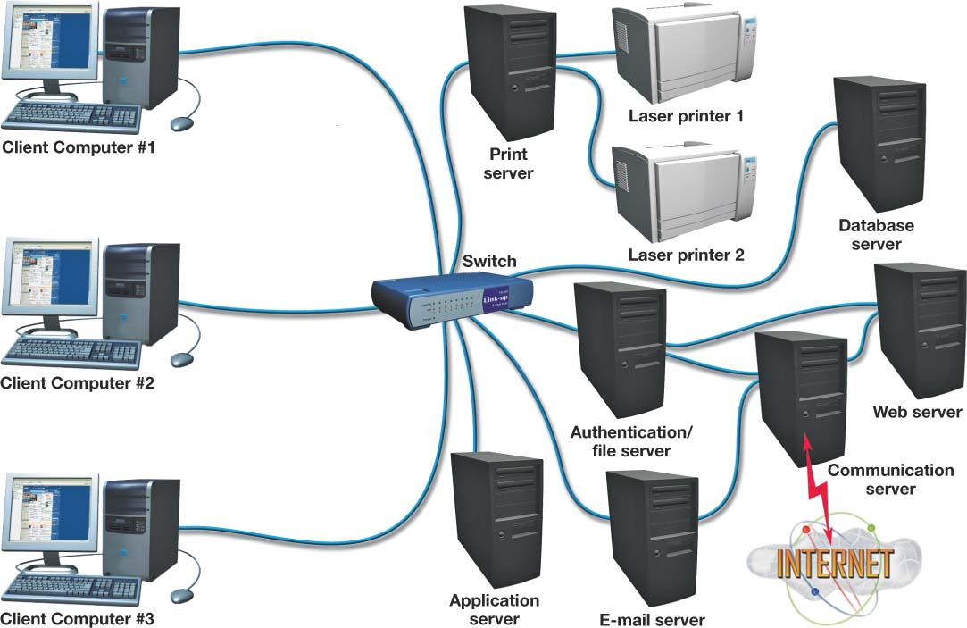
Servers
Number and type of servers depend on network size and workload
Dedicated server
  Performs one specific function
Authentication server
  Keeps track of network logins and services available
File server
  Stores and manages files
Notes:
Servers are the workhorses of the client/server network. They serve many different network users and assist them with accomplishing a variety of tasks.
The number and types of servers on a client/server network depend on the network’s size and workload.
As more users are added to a network, dedicated servers are used to fulfill one specific function (such as handling e-mail). When dedicated servers are deployed, the main server then becomes merely an authentication server and/or a file server.
Authentication servers keep track of who is logging on to the network and which services on the network are available to each user. Authentication servers also act as overseers for the network. They manage and coordinate the services provided by any other dedicated servers located on the network.
File servers store and manage files for network users. On corporate networks, employees are provided with space on a file server to store files they create.

Slide 9
Dedicated Servers
Print server
  Manages client-requested printing jobs
  Creates print queue (prioritizes print jobs)
Applications server
  Acts as a storage area for application software
Database server
  Provides clients with access to database information
E-mail server
  Processes and delivers in-coming and outgoing
  e-mail
Notes:
Any task that is repetitive or demands a lot of time of the server’s processor (CPU) is a good candidate to relegate to a dedicated server.
A network with a centralized printing service will have a print server that routes print jobs to appropriate devices and prioritizes printing according to order of request, unless overridden by special needs.
Application servers store and distribute as needed a set of application software for each system on the network. In these configurations, upgrades and new software installs are done just once on this server rather than deploying the programs throughout the organization.
Database servers are dedicated to an organization’s database storage, queries, and retrievals.
In large organizations e-mail servers handle the large volume of incoming, outgoing, and internal e-mail.

Slide 10
Dedicated Servers
Communications server
  Handles communications between networks including the Internet
  Often the only device on the network directly connected to the Internet
Web server
  Hosts a Web site available through
  the Internet
Notes:
A communications server handles all communications between the network and other networks, including managing Internet connectivity. All requests for information from the Internet and all messages being sent through the Internet pass through the communications server.
Often, the communications server is the only device on the network connected to the Internet. E-mail servers, Web servers, and other devices needing to communicate with the Internet usually route all their traffic through the communications server. Providing a single point of contact with the outside world makes it easier to secure the network from hackers.
A Web server is used to host a Web site available through the Internet. Web servers run specialized software that enables them to host Web pages.

Slide 11
P2P Networking/Computing
P2P computing is the sharing of computer resources and services by direct exchange between systems.
These resources and services include the exchange of information, processing cycles, cache storage, and disk storage for files.
P2P computing takes advantage of existing computing power, computer storage and networking connectivity, allowing users to leverage their collective power to the “benefit” of all.

Slide 12
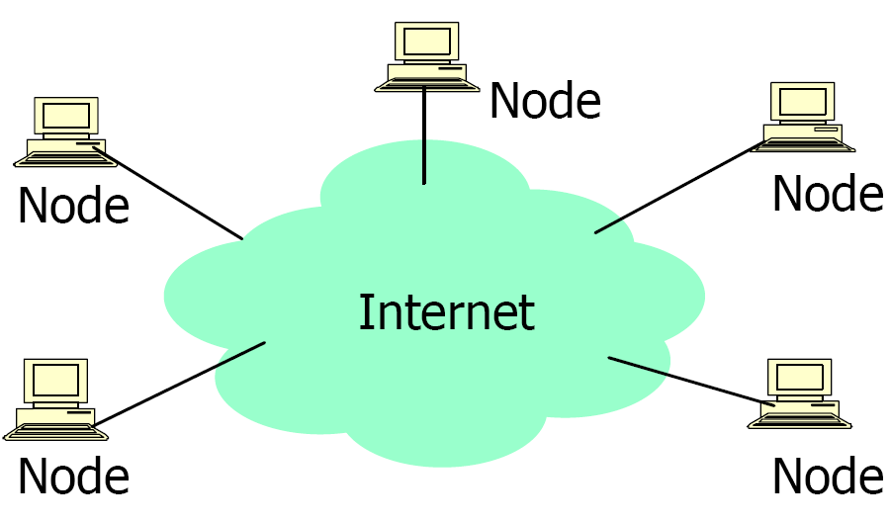
P2P Architecture
All nodes are both clients and servers
  Provide and consume data
  Any node can initiate a connection
No centralized data source
  “The ultimate form of democracy on the Internet”
  “The ultimate threat to copy-right protection on the Internet

Slide 13
What is P2P?
A distributed system architecture
  No centralized control
  Typically many nodes, but unreliable and heterogeneous
  Nodes are symmetric in function
  Take advantage of distributed, shared resources (bandwidth, CPU, storage) on peer-nodes
  Fault-tolerant, self-organizing
  Operate in dynamic environment, frequent join and leave is the norm
Internet

Slide 14
P2P Network Characteristics
Clients are also servers and routers
  Nodes contribute content, storage, memory, CPU
Nodes are autonomous (no administrative
authority)
Network is dynamic: nodes enter and leave the network “frequently”
Nodes collaborate directly with each other (not through well-known servers)
Nodes have widely varying capabilities

Slide 15
P2P vs. Client/Server
Pure P2P:
  No central server
  For certain requests any peer can function as a client, as a router, or as a server
  The information is not located in a central location but is distributed among all peers
  A peer may need to communicate with multiple peers to locate a piece of information
As more peers are added, both demand
and capacity of the network increases !

Slide 16
P2P Benefits
Efficient use of resources
  Unused bandwidth, storage, processing power at the edge of the network
Scalability
  Consumers of resources also donate resources
  Aggregate resources grow naturally with utilization
Reliability
  Replicas
  Geographic distribution
  No single point of failure
Ease of administration
  Nodes self organize
  No need to deploy servers to satisfy demand (c.f. scalability)
  Built-in fault tolerance, replication, and load balancing

Slide 17
Difference between Client-Server and Peer-to-Peer Network:
S.NO | CLIENT-SERVER NETWORK | PEER-TO-PEER NETWORK
1. | In Client-Server Network, Clients and server are differentiated, Specific server and clients are present. | In Peer-to-Peer Network, Clients and server are not differentiated.
2. | Client-Server Network focuses on information sharing. | While Peer-to-Peer Network focuses on connectivity.
3. | In Client-Server Network, Centralized server is used to store the data. | While in Peer-to-Peer Network, Each peer has its own data.
4. | In Client-Server Network, Server respond the services which is request by Client. | While in Peer-to-Peer Network, Each and every node can do both request and respond for the services.
5. | Client-Server Network are costlier than Peer-to-Peer Network. | While Peer-to-Peer Network are less costlier than Client-Server Network.
6. | Client-Server Network are more stable than Peer-to-Peer Network. | While Peer-to-Peer Network are less stable if number of peer is increase.
7. | Client-Server Network is used for both small and large networks. | While Peer-to-Peer Network is generally suited for small networks with fewer than 10 computers

Slide 18
2-1 LAYERED TASKS
We use the concept of layers in our daily life. As an example, let us consider two friends who communicate through postal mail. The process of sending a letter to a friend would be complex if there were no services available from the post office.
Topics discussed in this section:
Sender, Receiver, and Carrier
Hierarchy

Slide 19
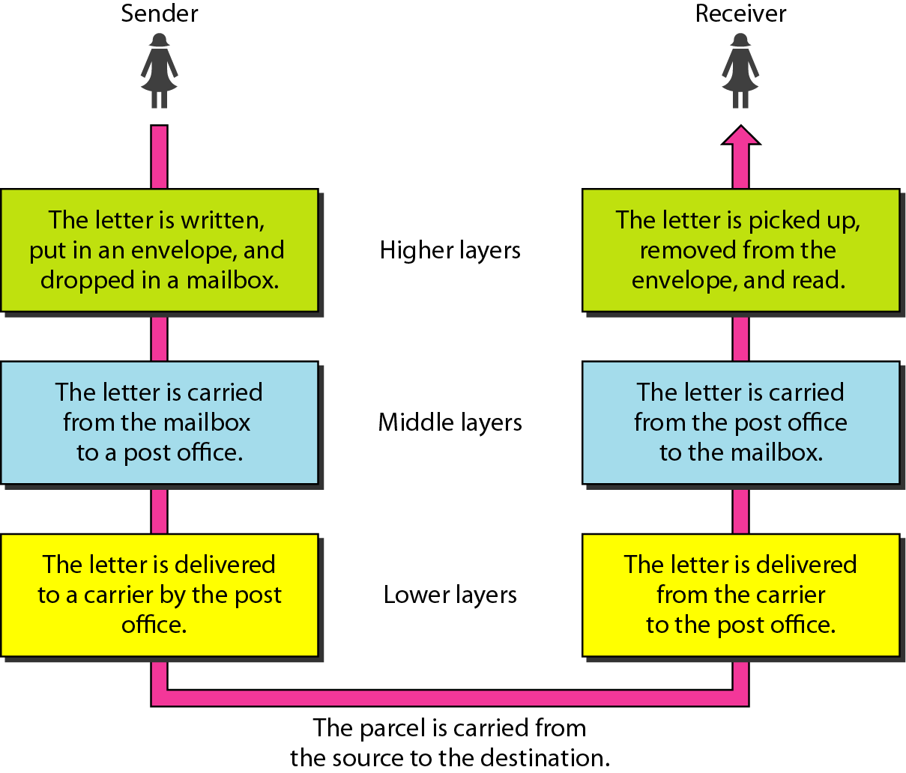
Figure 2.1 Tasks involved in sending a letter

Slide 20
2-2 THE OSI MODEL
Established in 1947, the International Standards Organization (ISO) is a multinational body dedicated to worldwide agreement on international standards. An ISO standard that covers all aspects of network communications is the Open Systems Interconnection (OSI) model. It was first introduced in the late 1970s.
Topics discussed in this section:
Layered Architecture
Peer-to-Peer Processes
Encapsulation

Slide 21

Note
ISO is the organization.
OSI is the model.

Slide 22
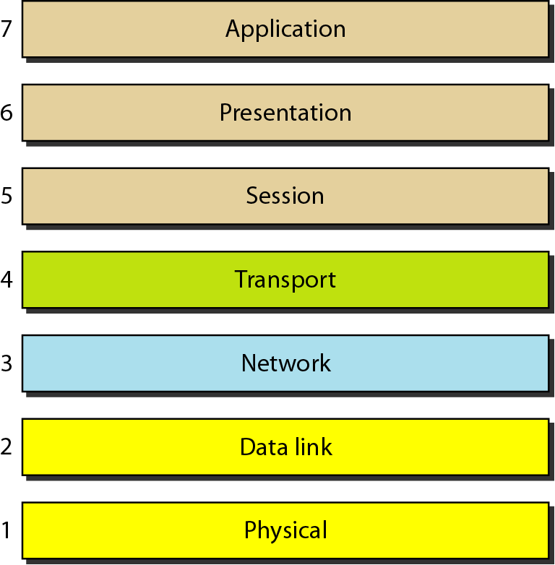
Figure 2.2 Seven layers of the OSI model

Slide 23
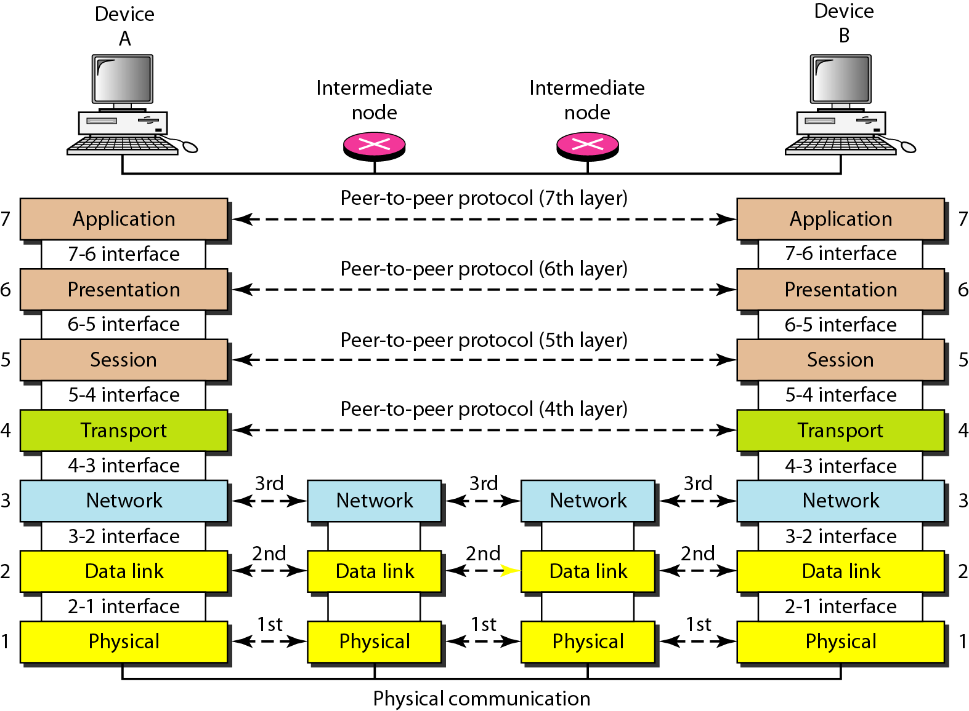
Figure 2.3 The interaction between layers in the OSI model

Slide 24
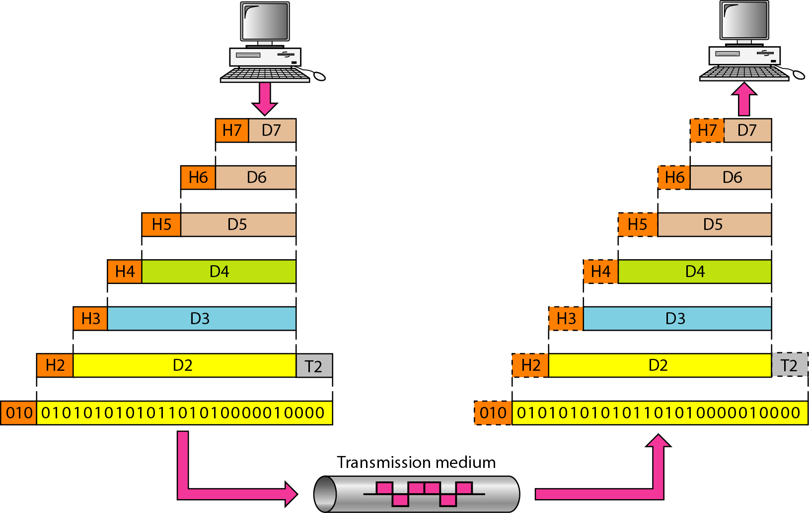
Figure 2.4 An exchange using the OSI model

Slide 25
2-3 LAYERS IN THE OSI MODEL
In this section we briefly describe the functions of each layer in the OSI model.
Topics discussed in this section:
Physical Layer
Data Link Layer
Network Layer
Transport Layer
Session Layer
Presentation Layer
Application Layer

Slide 26
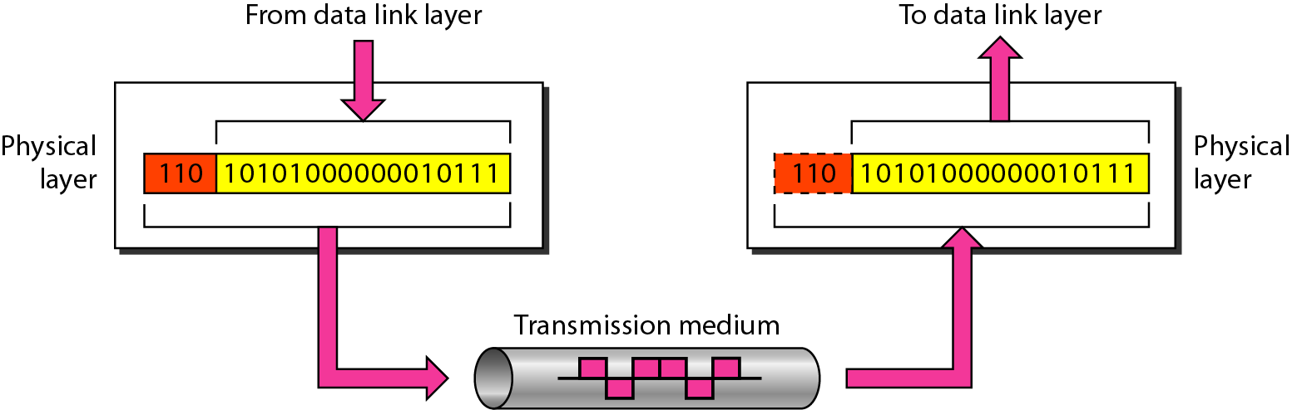
Figure 2.5 Physical layer

Slide 27
Note
The physical layer is responsible for movements of
individual bits from one hop (node) to the next.

Slide 28
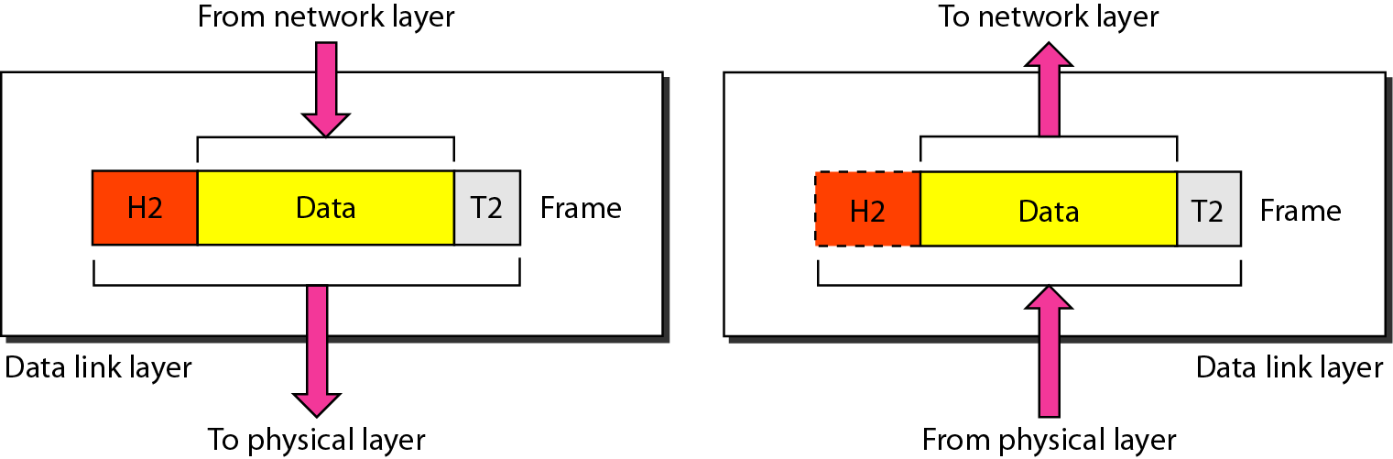
Figure 2.6 Data link layer

Slide 29
Note
The data link layer is responsible for moving
frames from one hop (node) to the next.

Slide 30
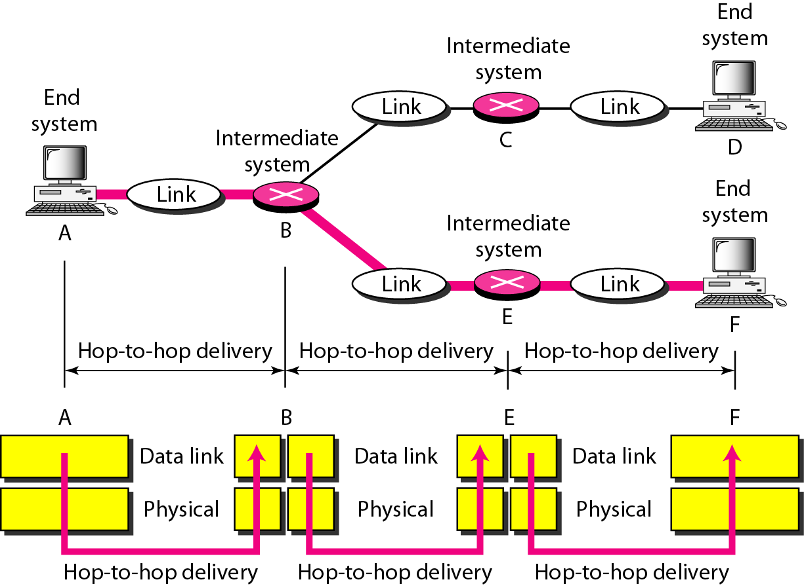
Figure 2.7 Hop-to-hop delivery

Slide 31
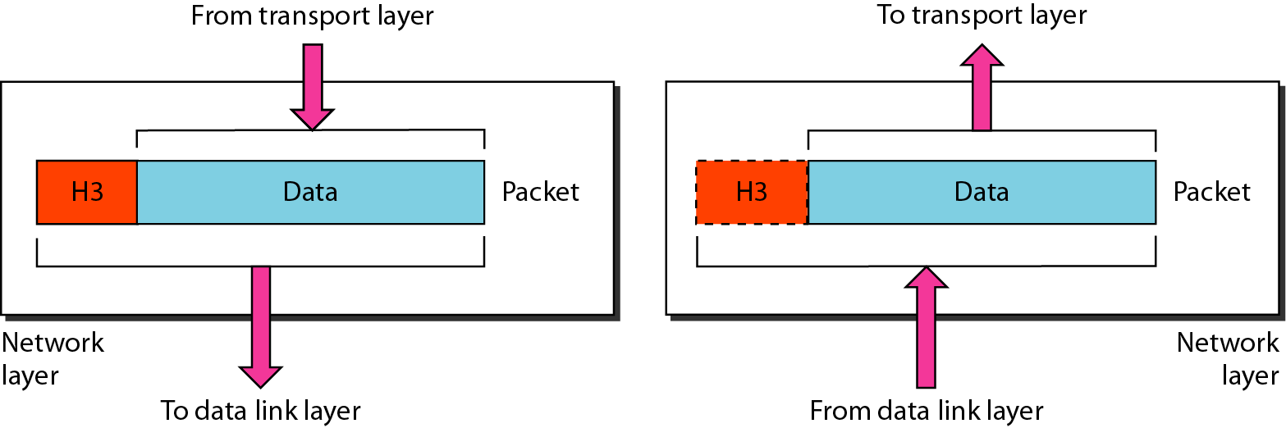
Figure 2.8 Network layer

Slide 32
Note
The network layer is responsible for the
delivery of individual packets from
the source host to the destination host.

Slide 33
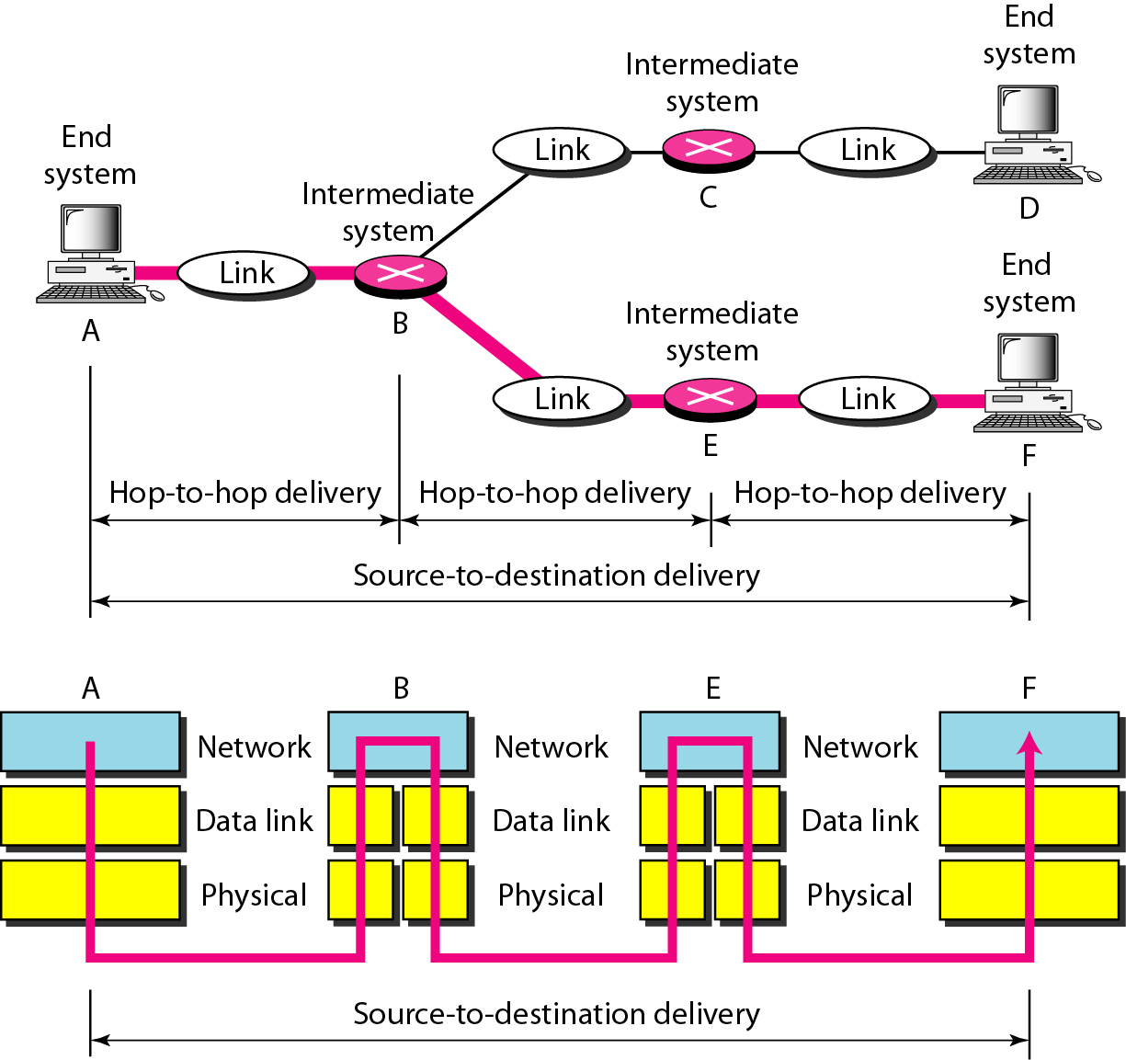
Figure 2.9 Source-to-destination delivery

Slide 34
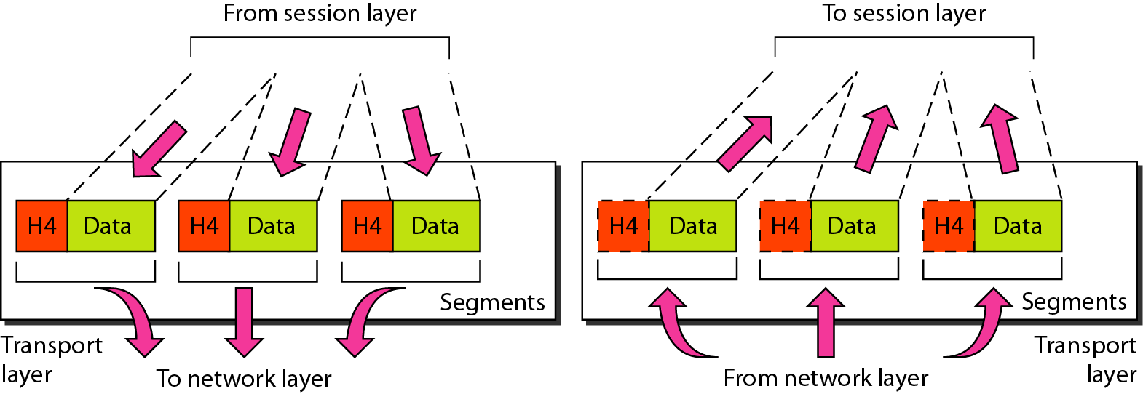
Figure 2.10 Transport layer

Slide 35
Note
The transport layer is responsible for the delivery
of a message from one process to another.

Slide 36
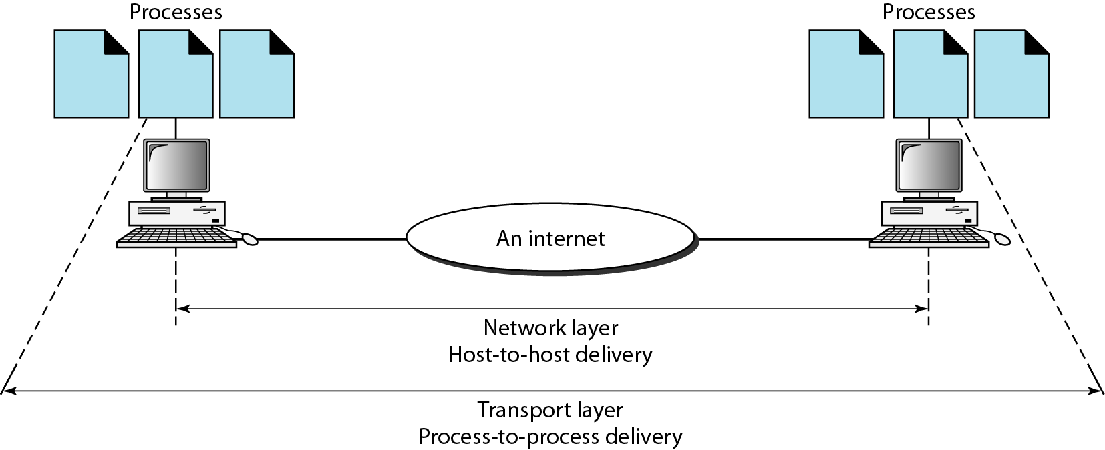
Figure 2.11 Reliable process-to-process delivery of a message

Slide 37
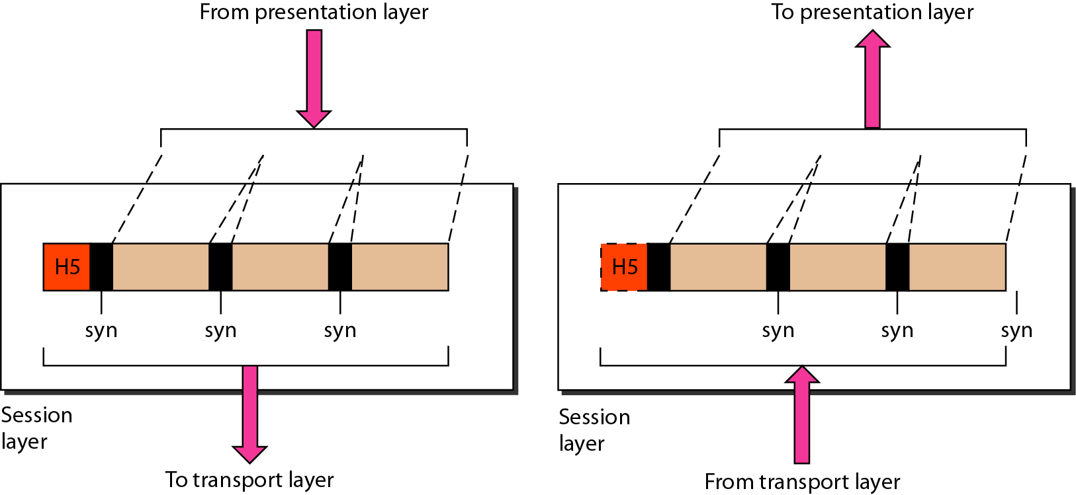
Figure 2.12 Session layer

Slide 38
Note
The session layer is responsible for dialog
control and synchronization.

Slide 39
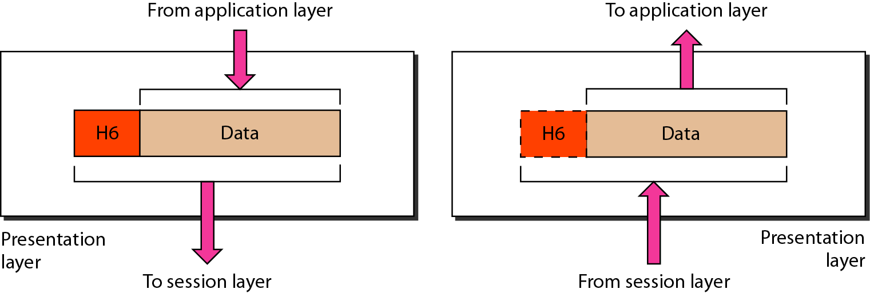
Figure 2.13 Presentation layer

Slide 40
Note
The presentation layer is responsible for translation, compression, and encryption.

Slide 41
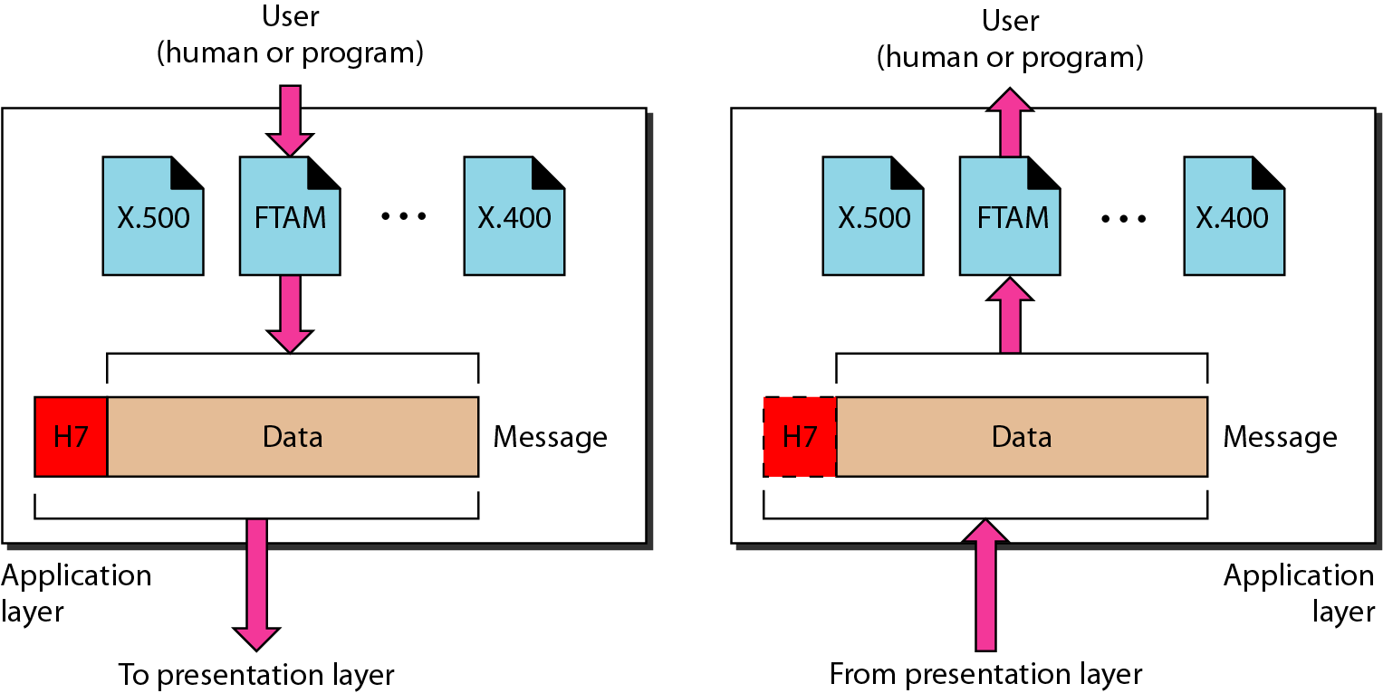
Figure 2.14 Application layer

Slide 42
Note
The application layer is responsible for
providing services to the user.

Slide 43
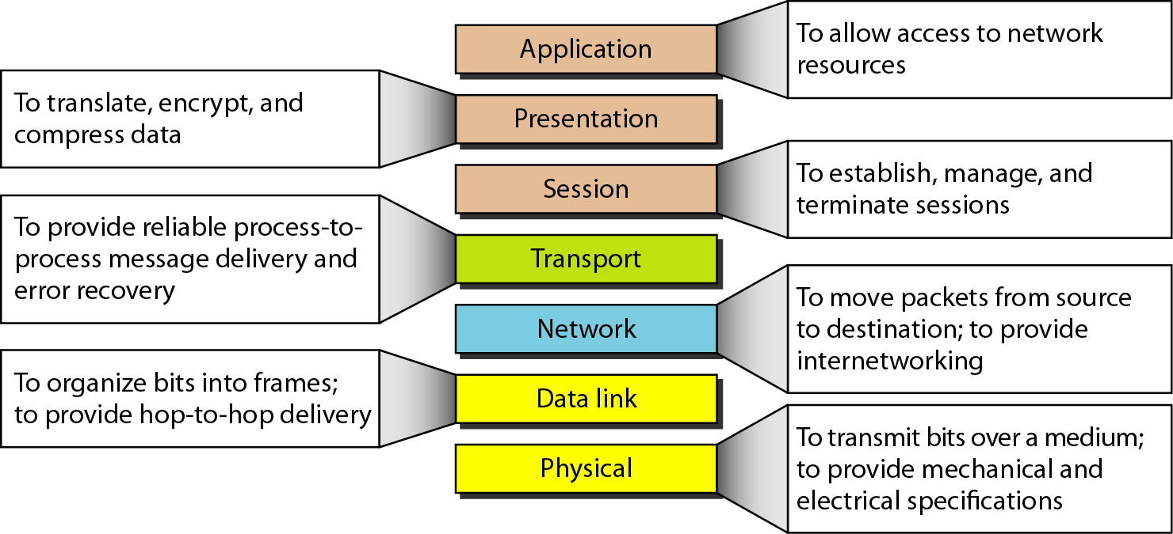
Figure 2.15 Summary of layers

Slide 44
2-4 TCP/IP PROTOCOL SUITE
The layers in the TCP/IP protocol suite do not exactly match those in the OSI model. The original TCP/IP protocol suite was defined as having four layers: host-to-network, internet, transport, and application. However, when TCP/IP is compared to OSI, we can say that the TCP/IP protocol suite is made of five layers: physical, data link, network, transport, and application.
Topics discussed in this section:
Physical and Data Link Layers
Network Layer
Transport Layer
Application Layer

Slide 45
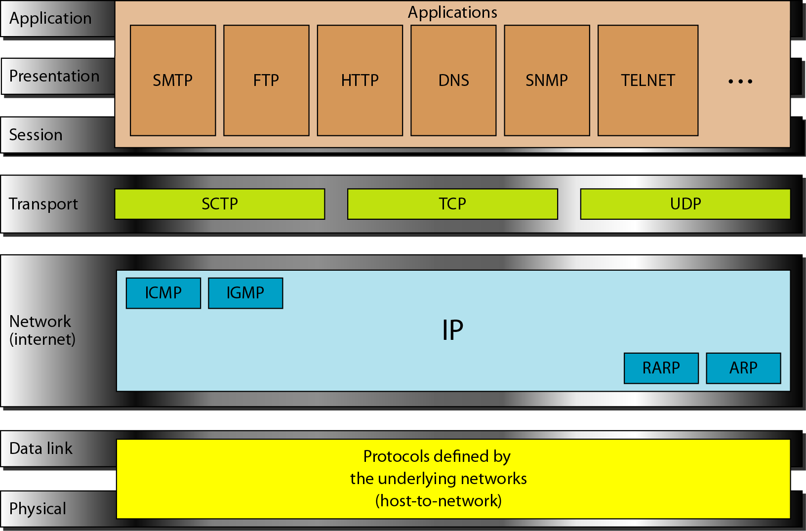
Figure 2.16 TCP/IP and OSI model

Slide 46
2-5 ADDRESSING
Four levels of addresses are used in an internet employing the TCP/IP protocols: physical, logical, port, and specific.
Topics discussed in this section:
Physical Addresses
Logical Addresses
Port Addresses
Specific Addresses

Slide 47
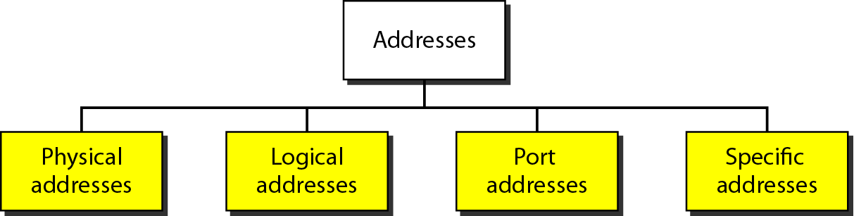
Figure 2.17 Addresses in TCP/IP

Slide 48
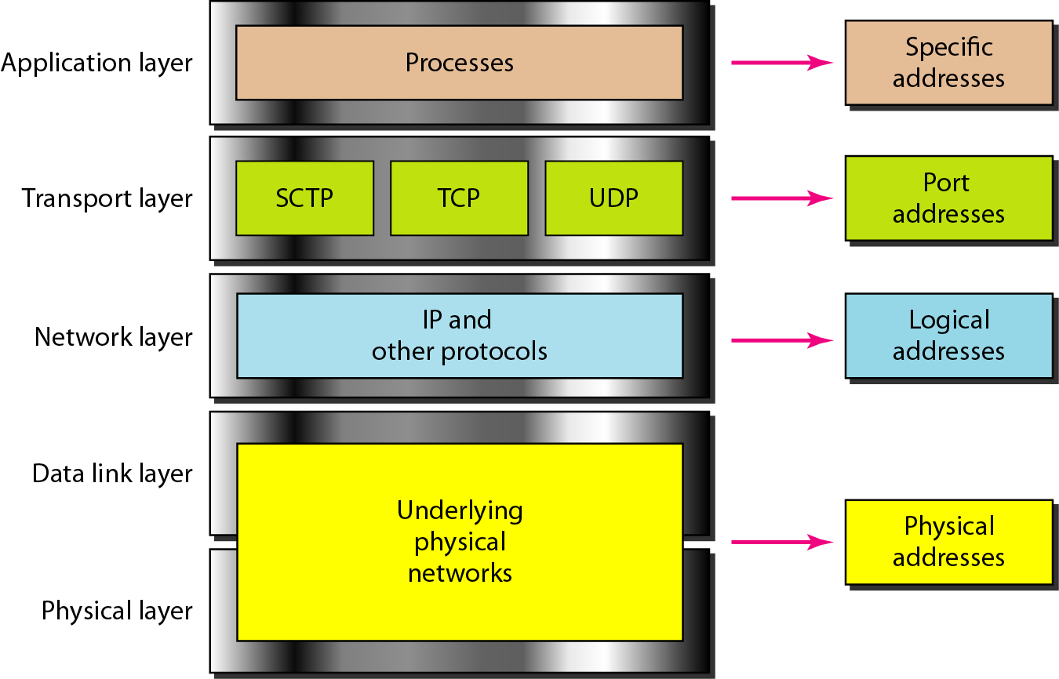
Figure 2.18 Relationship of layers and addresses in TCP/IP

Slide 49
Example 2.1
In Figure 2.19 a node with physical address 10 sends a frame to a node with physical address 87. The two nodes are connected by a link (bus topology LAN). As the figure shows, the computer with physical address 10 is the sender, and the computer with physical address 87 is the receiver.

Slide 50
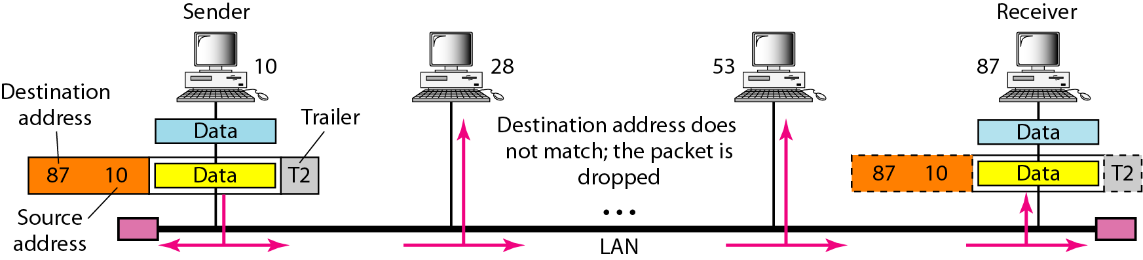
Figure 2.19 Physical addresses

Slide 51
Example 2.2
Most local-area networks use a 48-bit (6-byte) physical address written as 12 hexadecimal digits; every byte (2 hexadecimal digits) is separated by a colon, as shown below:
07:01:02:01:2C:4B
A 6-byte (12 hexadecimal digits) physical address.

Slide 52
Example 2.3
Figure 2.20 shows a part of an internet with two routers connecting three LANs. Each device (computer or router) has a pair of addresses (logical and physical) for each connection. In this case, each computer is connected to only one link and therefore has only one pair of addresses. Each router, however, is connected to three networks (only two are shown in the figure). So each router has three pairs of addresses, one for each connection.

Slide 53
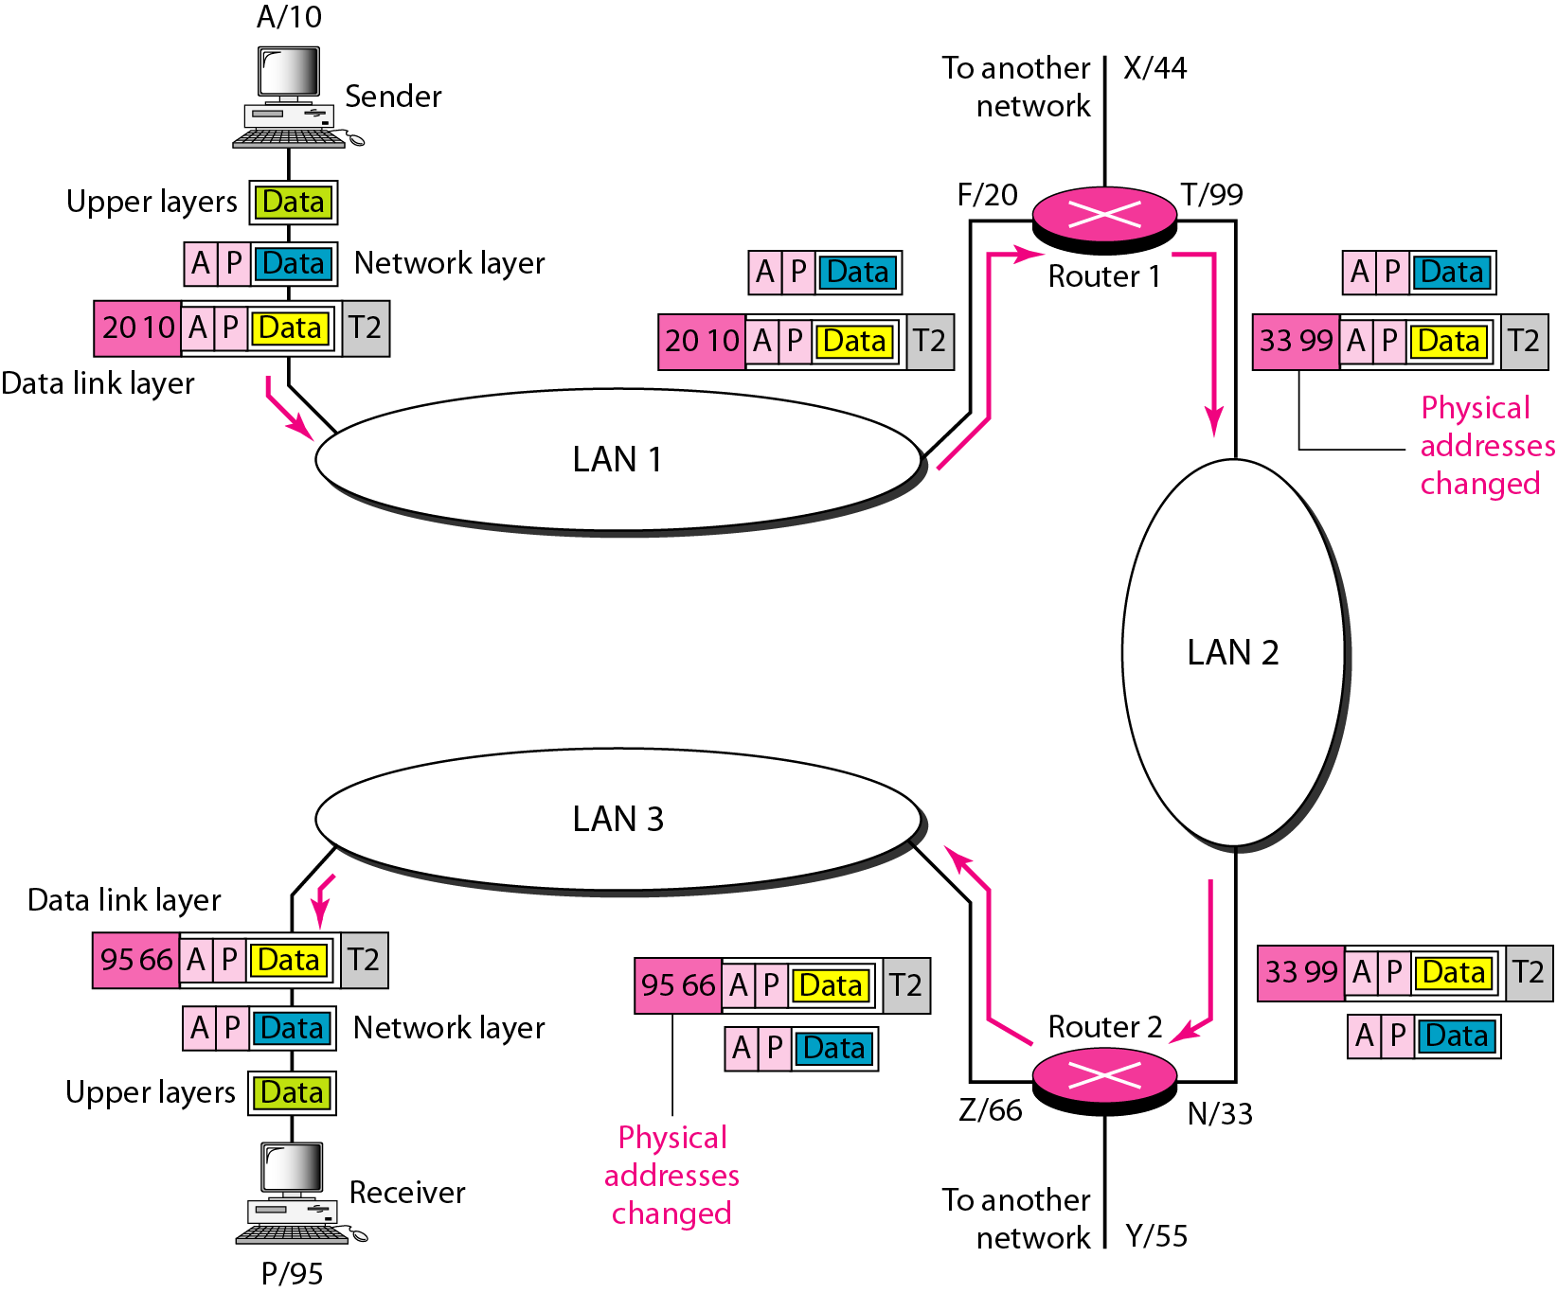
Figure 2.20 IP addresses

Slide 54
Example 2.4
Figure 2.21 shows two computers communicating via the Internet. The sending computer is running three processes at this time with port addresses a, b, and c. The receiving computer is running two processes at this time with port addresses j and k. Process a in the sending computer needs to communicate with process j in the receiving computer. Note that although physical addresses change from hop to hop, logical and port addresses remain the same from the source to destination.

Slide 55
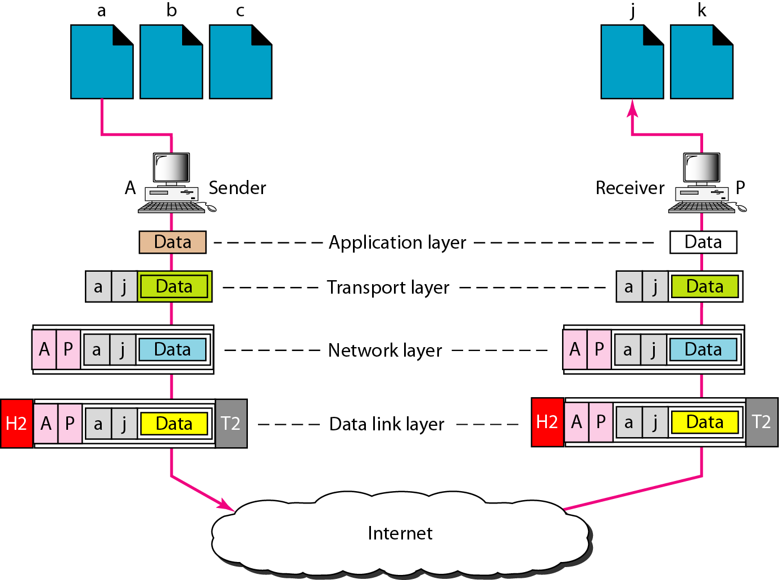
Figure 2.21 Port addresses

Slide 56
Note
The physical addresses will change from hop to hop,
but the logical addresses usually remain the same.

Slide 57
Example 2.5
A port address is a 16-bit address represented by one decimal number as shown.
753
A 16-bit port address represented
as one single number.

Slide 58
2-2 THE OSI MODEL
Established in 1947, the International Standards Organization (ISO) is a multinational body dedicated to worldwide agreement on international standards. An ISO standard that covers all aspects of network communications is the Open Systems Interconnection (OSI) model. It was first introduced in the late 1970s.
Topics discussed in this section:
Layered Architecture
Peer-to-Peer Processes
Encapsulation

Slide 59
7 Application
6 Presentation
5 Session
4 Transport
INTRODUCTION
3 Network
2 Data Link
1 Physical

Slide 60
7 Application
NETWORK GOALS
The two main benefits of networking computers are…
Communications
  Information can be distributed very quickly, such as email and video conferencing.
Saving Money
  Resources such as information, software, and hardware can be shared.
  CPUs and hard disks can be pooled together to create a more powerful machine.
6 Presentation
5 Session
4 Transport
3 Network
2 Data Link
1 Physical

Slide 61
7 Application
APPLICATIONS
A lot of things we take for granted are the result of computer networks.
  Email
  Chat
  Web sites
  Sharing of documents and pictures
  Accessing a centralized database of information
  Mobile workers
6 Presentation
5 Session
4 Transport
3 Network
2 Data Link
1 Physical

Slide 62
7 Application
NETWORK STRUCTURE
The subnet interconnects hosts.
Subnet
  Carries messages from host to host. It is made up of telecommunication lines (i.e. circuits, channels, trunks) and switching elements (i.e. IMPs, routers).
Hosts
  End user machines or computers.
Q: Is the host part of the subnet?
6 Presentation
5 Session
4 Transport
3 Network
2 Data Link
1 Physical

Slide 63
7 Application
NETWORK ARCHITECTURES
A set of layers and protocols is called the network architecture.
1. Protocol Hierarchies
  Networks are organized as layers to reduce design complexity. Each layer offers services to the higher layers. Between adjacent layers is an interface.
  Services – connection oriented and connectionless.
  Interface – defines which primitives and services the lower layer will offer to the upper layer.
  Primitives – operations such as request, indicate, response, confirm.
6 Presentation
5 Session
4 Transport
3 Network
2 Data Link
1 Physical

Slide 64
7 Application
NETWORK ARCHITECTURES
2. Design Issues for the Layers
  Mechanism for connection establishment
  Rules for data transfer
  Error control
  Fast sender swamping a slow receiver
  Inability of processes to accept long messages
  Routing in the case of multiple paths
6 Presentation
5 Session
4 Transport
3 Network
2 Data Link
1 Physical

Slide 65
7 Application
OSI REFERENCE MODEL
The Open Systems Interconnection is the model developed by the International Standards Organization.
Benefits
  Interconnection of different systems (open)
  Not limited to a single vendor solution
Negative Aspect
  Systems might be less secure
  Systems might be less stable
6 Presentation
5 Session
4 Transport
3 Network
2 Data Link
1 Physical

Slide 66
7 Application
OSI REFERENCE MODEL
1. Physical Layer
  a) Convert the logical 1’s and 0’s coming from layer 2 into electrical signals.
  b) Transmission of the electrical signals over a communication channel.
  Main topics:
  Transmission mediums
  Encoding
  Modulation
  RS232 and RS422 standards
  Repeaters
  Hubs (multi-port repeater)
6 Presentation
5 Session
4 Transport
3 Network
2 Data Link
1 Physical

Slide 67
7 Application
OSI REFERENCE MODEL
2. Data Link Layer
  a) Error control to compensate for the imperfections of the physical layer.
  b) Flow control to keep a fast sender from swamping a slow receiver.
  Main topics:
  Framing methods
  Error detection and correction methods
  Flow control
  Frame format
  IEEE LAN standards
  Bridges
  Switches (multi-port bridges)
6 Presentation
5 Session
4 Transport
3 Network
2 Data Link
1 Physical

Slide 68
7 Application
OSI REFERENCE MODEL
3. Network Layer
  a) Controls the operation of the subnet.
  b) Routing packets from source to destination.
  c) Logical addressing.
  Main topics:
  Internetworking
  Routing algorithms
  Internet Protocol (IP) addressing
  Routers
6 Presentation
5 Session
4 Transport
3 Network
2 Data Link
1 Physical

Slide 69
7 Application
OSI REFERENCE MODEL
4. Transport Layer
  a) Provides additional Quality of Service.
  b) Heart of the OSI model.
  Main topics:
  Connection-oriented and connectionless services
  Transmission Control Protocol (TCP)
  User Datagram Protocol (UDP)
6 Presentation
5 Session
4 Transport
3 Network
2 Data Link
1 Physical

Slide 70
7 Application
OSI REFERENCE MODEL
5. Session Layer
  a) Allows users on different machines to establish sessions between them.
  b) One of the services is managing dialogue control.
  c) Token management.
  d) Synchronization.
6 Presentation
5 Session
4 Transport
3 Network
2 Data Link
1 Physical

Slide 71
7 Application
OSI REFERENCE MODEL
6. Presentation Layer
  a) Concerned with the syntax and semantics of the information.
  b) Preserves the meaning of the information.
  c) Data compression.
  d) Data encryption.
6 Presentation
5 Session
4 Transport
3 Network
2 Data Link
1 Physical

Slide 72
7 Application
OSI REFERENCE MODEL
7. Application Layer
  a) Provides protocols that are commonly needed.
  Main topics:
  File Transfer Protocol (FTP)
  HyperText Transfer Protocol (HTTP)
  Simple Mail Transfer Protocol (SMTP)
  Simple Network Management Protocol (SNMP)
  Network File System (NFS)
  Telnet
6 Presentation
5 Session
4 Transport
3 Network
2 Data Link
1 Physical

Slide 73
7 Application
SERVICES
Each layer provides services to the layer above it.
1. Terminologies
  Entities – active elements in each layer (e.g. process, intelligent I/O chip).
  Peer Entities – entities in the same layer on different machines.
  Service Provider – Layer N.
  Service User – Layer N + 1.
  Service Access Points – places where layer N + 1 can access services offered by layer N.
6 Presentation
5 Session
4 Transport
3 Network
2 Data Link
1 Physical

Slide 74
7 Application
SERVICES
2. Connection-Oriented and Connectionless
  Connection-Oriented – before data is sent, the service from the sending computer must establish a connection with the receiving computer.
  Connectionless – data can be sent at any time by the service from the sending computer.
Q: Is downloading a music file from the Internet
connection-oriented or connectionless?
Q: Is email connection-oriented or connectionless?
6 Presentation
5 Session
4 Transport
3 Network
2 Data Link
1 Physical

Slide 75
7 Application
SERVICES
3. Service Primitives
  Request – entity wants the service to do some work
  Indicate – entity is to be informed about an event
  Response – entity responds to an event
  Confirm – entity is to be informed about its request
Sending Computer Receiving Computer
6 Presentation
5 Session
4 Transport
3 Network
2 Data Link
4 Transport
4 Transport
1 Physical
1. request
4. confirm
2. indicate
3. response
3 Network
3 Network

Slide 76
7 Application
BANDWIDTH
The capacity of the medium to transmit data.
Analog Bandwidth
  Measurement is in Hertz (Hz) or cycles/sec.
Digital Bandwidth
  Measurement is in bits per second (bps).
Q: Is 100MHz = 100Mbps?
Q: Is 100Mbps = 100MBps?
6 Presentation
5 Session
4 Transport
3 Network
2 Data Link
1 Physical

Slide 77
7 Application
TRANSMISSION MEDIA
1. Guided
  Data is sent via a wire or optical cable.
  Twisted Pair
  Two copper wires are twisted together to reduce the effect of crosstalk noise. (e.g. Cat5, UTP, STP)
  Baseband Coaxial Cable
  A 50-ohm cable used for digital transmission. Used in 10Base2 and 10Base5.
  Broadband Coaxial Cable
  A 75-ohm cable used for analog transmission such as Cable TV.
6 Presentation
5 Session
4 Transport
3 Network
2 Data Link
1 Physical

Slide 78
7 Application
TRANSMISSION MEDIA
  Fiber Optic Cables
  Two general types are multimode and single mode.
  In multimode, light is reflected internally. Light source is an LED.
  In single mode, the light propagates in a straight line. Light source come from expensive laser diodes. Faster and longer distances as compared to multimode.
  * Fiber optic cables are difficult to tap (higher security)
  and are normally used for backbone cabling.
6 Presentation
5 Session
4 Transport
3 Network
2 Data Link
1 Physical

Slide 79
7 Application
TRANSMISSION MEDIA
2. Unguided
  Data is sent through the air.
  Line-of-sight
  Transmitter and receiver must “see” each other, such as a terrestrial microwave system.
  Communication Satellites
  A big microwave repeater in the sky. Data is broadcasted, and can be “pirated.”
  Radio
  Term used to include all frequency bands, such as FM, UHF, and VHF television.
6 Presentation
5 Session
4 Transport
3 Network
2 Data Link
1 Physical

Slide 80
7 Application
ANALOG TRANSMISSION
1. Modulation
  Modulating a sine wave carrier to convey data.
  Amplitude Modulation (AM)
  Amplitude is increased/decreased while frequency remains constant.
  Frequency Modulation (FM)
  Frequency is increased/decreased while amplitude remains constant.
  Phase Modulation
  Wave is shifted, while amplitude and frequency remains constant.
6 Presentation
5 Session
4 Transport
3 Network
2 Data Link
1 Physical

Slide 81
7 Application
ANALOG TRANSMISSION
2. Modems
  A device that accepts digital signals and outputs a modulated carrier wave, and vice versa.
  It is used to interconnect the digital computer to the analog telephone network.
  * Modems for PC’s can be external or internal.
  * Nokia makes modems for leased line connections.
6 Presentation
5 Session
4 Transport
3 Network
2 Data Link
1 Physical

Slide 82
7 Application
ANALOG TRANSMISSION
3. RS-232 and RS-449
  Two well known physical layer standards.
  RS-232
  20 kbps
  Cables up to 15 meters
  Unbalanced transmission (common ground)
  RS-422
  2 Mbps at 60 meters
  1 Mbps at 100 meters
  Balanced transmission (a pair of wires for Tx, Rx)
6 Presentation
5 Session
4 Transport
3 Network
2 Data Link
1 Physical

Slide 83
7 Application
DIGITAL TRANSMISSION
1. Encoding Schemes
  Converting logical data into electrical signals suitable for transmission.
  Manchester
  Mid bit transition for clock synchronization and data
  Logic 0 = high to low transition
  Logic 1 = low to high transition
  Differential Manchester
  Mid bit transition for clock synchronization only
  Logic 0 = transition at the beginning of each bit period
  Logic 1 = no transition at the beginning of each bit period
6 Presentation
5 Session
4 Transport
3 Network
2 Data Link
1 Physical

Slide 84

7 Application
DIGITAL TRANSMISSION
2. Repeaters and Hubs
  These are physical layer devices.
  Repeaters
  Restores the strength of an attenuated signal.
  Used to increase the transmission distance.
  Does not filter data traffic.
  Hubs
  Multi-port repeater.
  Interconnects several computers.
  Does not filter data traffic.
6 Presentation
5 Session
4 Transport
3 Network
2 Data Link
1 Physical
* Picture from 3com.com

Slide 85
7 Application
6 Presentation
5 Session
4 Transport
NETWORK LAYER
3 Network
2 Data Link
1 Physical

Slide 86
7 Application
OVERVIEW
Routing Algorithms
  Shortest Path
  Flooding
  Flow-based
  Distance Vector
  Link State
  Hierarchical
  Broadcast
  Multicast
  Routing for Mobile Hosts
Congestion control
IP Addressing
Routers
6 Presentation
5 Session
4 Transport
3 Network
2 Data Link
1 Physical

Slide 87
7 Application
ROUTING ALGORITHMS
1. Shortest Path
6 Presentation
B(A,2)
C(B,3)
5 Session
B
1
C
2
4 Transport
3
2
3
A(-,-)
2
D(E,3)
A
3 Network
D
F(E,4)
1
1
F
2 Data Link
2
E(A,2)
2
E
1 Physical
A – E – D – F
A – E – F is the answer.

Slide 88
7 Application
ROUTING ALGORITHMS
2. Flooding
6 Presentation
5 Session
IMP
B
Packet to IMP C
Packet
Packet to IMP D
4 Transport
Packet to IMP E
To prevent packets from circulating indefinitely, a packet has a hop counter. Every time a packet arrives at an IMP, the hop counter is decrease by 1. Once the hop counter of a packet reaches 0, the packet is discarded.
3 Network
2 Data Link
1 Physical

Slide 89
7 Application
IP ADDRESSING
Format
x x x x x x x x . x x x x x x x x . x x x x x x x x . x x x x x x x x
where x is either 0 or 1
Example 1:
1 1 1 1 1 1 1 1 . 1 1 1 1 1 1 1 1 . 0 0 0 0 0 0 0 0 . 0 0 0 0 0 0 0 0
255.255.0.0
Example 2:
1 1 1 1 1 1 1 1 . 1 1 1 1 1 1 1 1 . 1 0 0 0 0 0 0 0 . 0 0 0 0 0 0 0 0
255.255.192.0
6 Presentation
5 Session
4 Transport
3 Network
2 Data Link
1 Physical

Slide 90
7 Application
IP ADDRESSING
Network Address
Example 1:
IP address of computer 180.100.7.1
Mask 255.255.0.0
Network address 180.100.0.0
Example 2:
IP address of computer 180.100.7.1
Mask 255.255.255.0
Network address 180.100.7.0
Example 3:
IP address of computer 180.100.7.2
Mask 255.255.192.0
Network address 180.100.0.0
6 Presentation
5 Session
4 Transport
3 Network
2 Data Link
1 Physical

Slide 91
7 Application
IP ADDRESSING
Mask
Valid mask are contiguous 1’s from left to right.
Examples:
  Valid
  255.0.0.0
  255.255.0.0
  255.255.255.0
  Invalid
  255.1.0.0
  255.0.255.0
  255.255.64.0
  200.255.0.0
6 Presentation
5 Session
4 Transport
3 Network
2 Data Link
1 Physical

Slide 92
7 Application
IP ADDRESSING
Subnets
The Internet is running out of IP address. One solution is to subnet a network address.
This is done by borrowing host bits to be used as network bits.
Example:
Class B mask 255.255.0.0
Borrowing 1 bit gives a subnet mask of 255.255.128.0
Borrowing 2 bits gives a subnet mask of 255.255.192.0
Borrowing 3 bits gives a subnet mask of 255.255.224.0
Borrowing 4 bits gives a subnet mask of 255.255.240.0
6 Presentation
5 Session
4 Transport
3 Network
2 Data Link
1 Physical

Slide 93
7 Application
IP ADDRESSING
Example:
Given an IP address of 180.200.0.0, subnet by borrowing 4 bits.
Subnet mask = 255.255.240.0
The 4 bits borrowed are value 128, 64, 32, 16. This will create 16 sub networks, where the first and last will be unusable.
Sub network address:
  180.200.0.0
  180.200.16.0
  180.200.32.0
  180.200.48.0
  180.200.64.0
  etc…
6 Presentation
5 Session
4 Transport
3 Network
2 Data Link
1 Physical

Slide 94
7 Application
IP ADDRESSING
The first 3 usable sub networks are:
180.200.16.0
180.200.32.0
180.200.48.0
For sub network 180.200.16.0, the valid IP address are:
180.200.16.1 to 180.200.31.254
Directed broadcast address is:
180.200.31.255
6 Presentation
5 Session
4 Transport
3 Network
2 Data Link
1 Physical

Slide 95
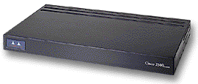
7 Application
ROUTERS
A layer 3 device that is used to interconnect 2 or more logical networks.
Can filter broadcast traffic, preventing broadcast traffic from one network from reaching another network.
6 Presentation
5 Session
4 Transport
180.200.0.0
202.5.3.0
3 Network
2 Data Link
1 Physical

Slide 96
Reference
Forouzan, B.A. Data Communicaiton and Networking, McGraw- Hill Education. Global edition 5e(© 2013).

